Slide 1

MAKEUOFT:
Personal Heart Rate Monitor
Serena Li, Olivia Zhang, Bary Yu

Slide 2
TABLE OF CONTENTS
01
02
03
04
BACKGROUND
ISSUES
Why this design?
Problems encountered during design
DECISION
PROPOSAL
Team decisions addressing the issues
The final design

Slide 3

01
BACKGROUND
Since we entered the age of entertainment, there has been significant increase cases of sudden death. Regardless of age.

Slide 4
02
ISSUES ENCOUNTERED
A
B
C
USER-INPUT
BMI Calculation
Voice Memo
There was no keypad available in-stock, we could not implement user-input feature
Problem A prevented the implementation of the user's BMI index feedback service
The USB to mini-USB type B adapter was rare. No voice notification implementation

Slide 5
03
TEAM DECISIONS
A
B
Decided to let go these features and add in LCD RGB Backlight Screen for display
Decided to continue the project implementation through gitHub

Slide 6
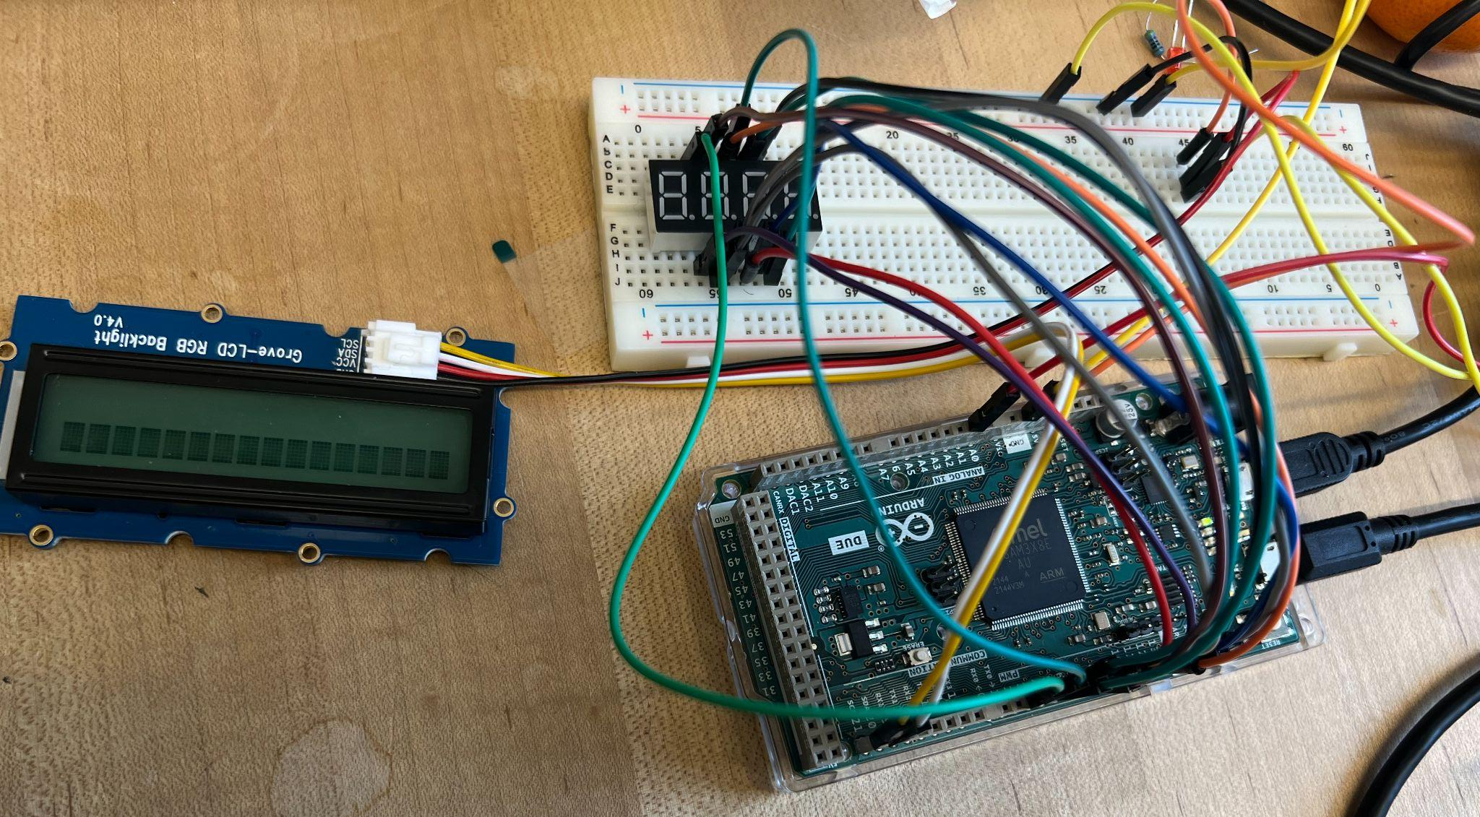
04
FINAL DESIGN
**Personal Heart Rate Monitor**
4-7 Segment Display
for Real-Time BPM
RGB Display for BPM
Arduino Due Connections

Slide 7

Take notice of your health.
Thank you for listening.
Sources: Some code templates were used from Arduino Due and DFRobot Open Sources.

